Slide 1
Functions of Technology Management
Decision Making

Slide 3
Chapter Objectives
Explain the process of management science.
Solve problems using three types of decision making tools

Slide 4
Relation to Planning
Managerial decision making is the process of making a conscious choice between two or more rational alternatives in order to select the one that will produce the most desirable consequences.
Decision making is an essential part of planning as planning is “deciding in advance what to do, how to do it, when to do it, and who is to do it.”

Slide 5
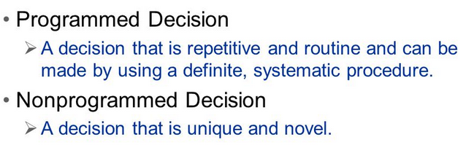
Types of Decisions

Slide 6
Routine Decisions – delegation/rules based
Payroll processing
Reordering standard inventory
Paying suppliers
Non-Routine Decisions
Unstructured situations
Usually more at higher level of management
Based on statistical decision making
Based on subjective decisions

Slide 7
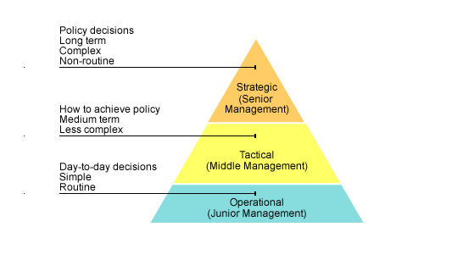

Slide 8
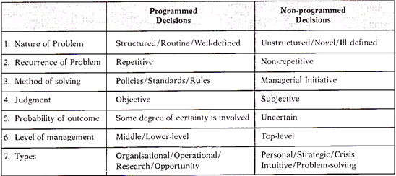
Engineers often find themselves unable to rise in management unless they can develop the “tolerance for ambiguity” that is needed to tackle unstructured problems.

Slide 9
Objective versus Bounded Rationality
Objective Rationality
Viewing all behavior alternatives
All consequences of choosing an alternative
Values assigned for singling out the alternative
Bounded Rationality
Take only known factors
Time and resource constraint
Choose action that is satisfactory or “good enough”
Solution that “satisfices” rather than the best one

Slide 10
Management Science Characteristics
Management science has been defined as having the following “primary distinguishing characteristics”:
A systems view of the problem – a viewpoint is taken that includes all of the significant interrelated variables contained in the problem.
The team approach – personnel with heterogeneous backgrounds and training work together on specific problems.
An emphasis on the use of formal mathematical models and statistical and quantitative techniques.

Slide 11
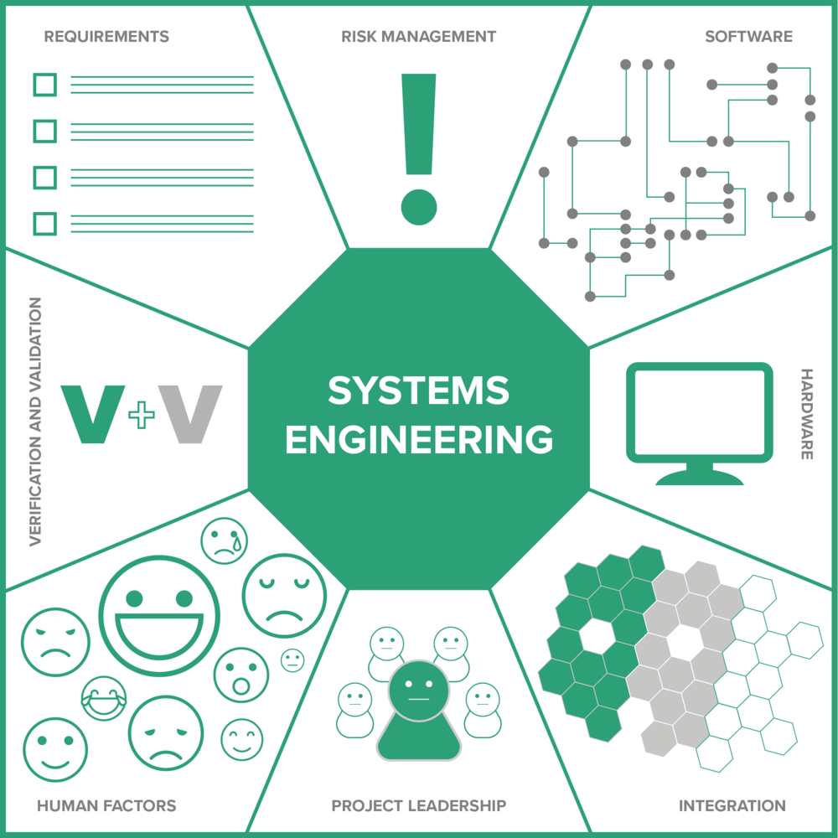
What Is Systems Engineering?
Systems engineering is an interdisciplinary approach and means to enable the realization of
successful systems. It focuses on defining customer needs and required functionality early in
the development cycle, documenting requirements, then proceeding with design synthesis and
system validation while considering the complete problem.

Slide 12
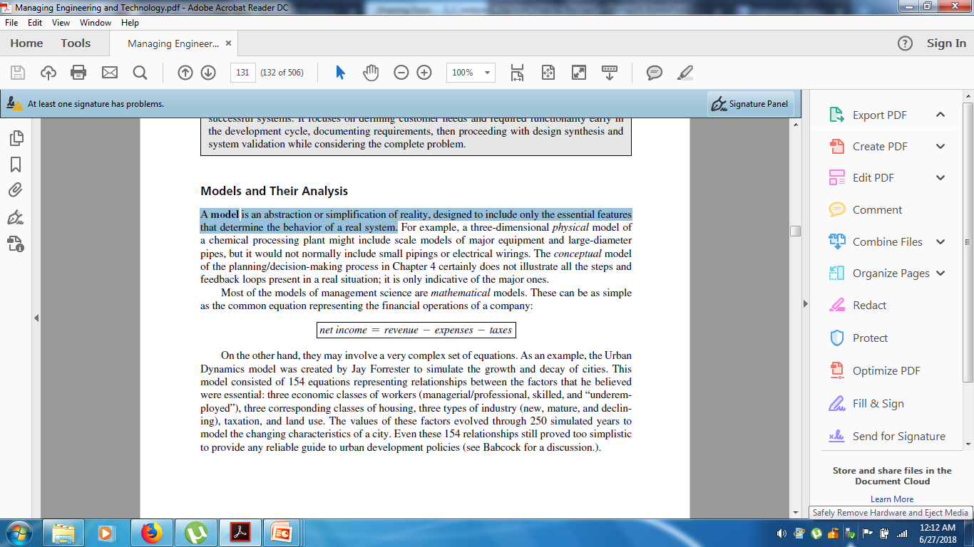
Models and Their Analysis
A model is an abstraction or simplification of reality, designed to include only the essential features that determine the behavior of a real system.
A simple equation (model) to represent the financial operations of a company:

Slide 13
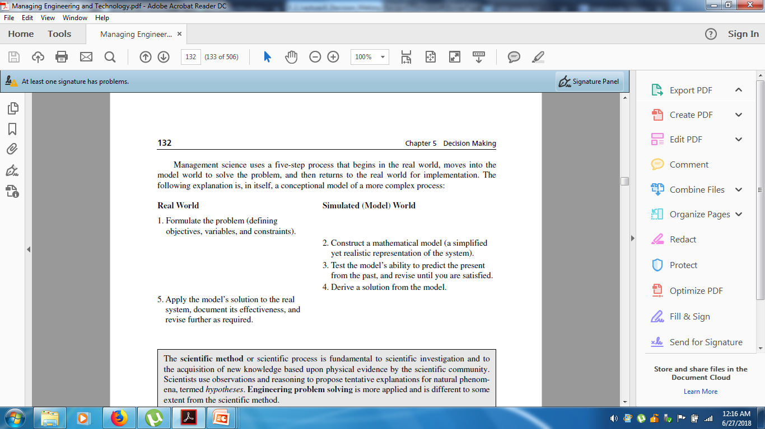
Management science uses a five-step process that begins in the real world, moves into the model world to solve the problem, then returns to the real world for implementation.

Slide 14
The scientific method or scientific process is fundamental to scientific investigation and to the acquisition of new knowledge based upon physical evidence by the scientific community.
Scientists use observations and reasoning to propose tentative explanations for natural phenomena, termed hypotheses. Engineering problem solving is more applied and is different to some extent from the scientific method.
Scientific Method Engineering Problem Solving Approach
• Define the problem. • Define the problem.
• Collect data. • Collect and analyze the data.
• Develop hypotheses. • Search for solutions.
• Test hypotheses. • Evaluate alternatives.
• Analyze results. • Select solution and evaluate the impact.
• Draw conclusion.

Slide 15
Tools for Decision Making
Categories of Decision Making
Decision Making under Certainty
Only one state of nature exists.
Linear Programming
Decision Making under Risk
Probabilities for states of natures are known.
Expected value, Decision trees, Queuing theory, and Simulation
Decision Making under Uncertainty
Probabilities for states of natures are unknown.
Game theory

Slide 16
Pay-off Table
 | State of Nature/Probability
 | N1 | N2 | … | Nj | … | Nn
Alternative | P1 | P2 | … | Pj | … | Pn
A1 | O11 | O12 |  | O1j |  | O1n
A2 | O21 | O22 |  | O2j |  | O2n
… | … | … | … | … | … | …
Ai | Oi1 | Oi2 |  | Oij |  | Oin
… | … | … | … | … | … | …
Am | Om1 | Om2 |  | Omj |  | Omn

Slide 17
Decision Making under Certainty
Linear programming
Graphical solution
Simplex method
Computer software
Non-linear programming
Engineering Economic Analysis

Slide 18
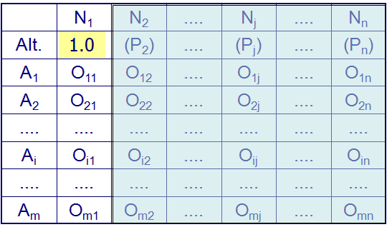

Slide 19
Steps in solving Linear Programming
State the problem
Identify decision variables
Objective function
Constraints

Slide 20
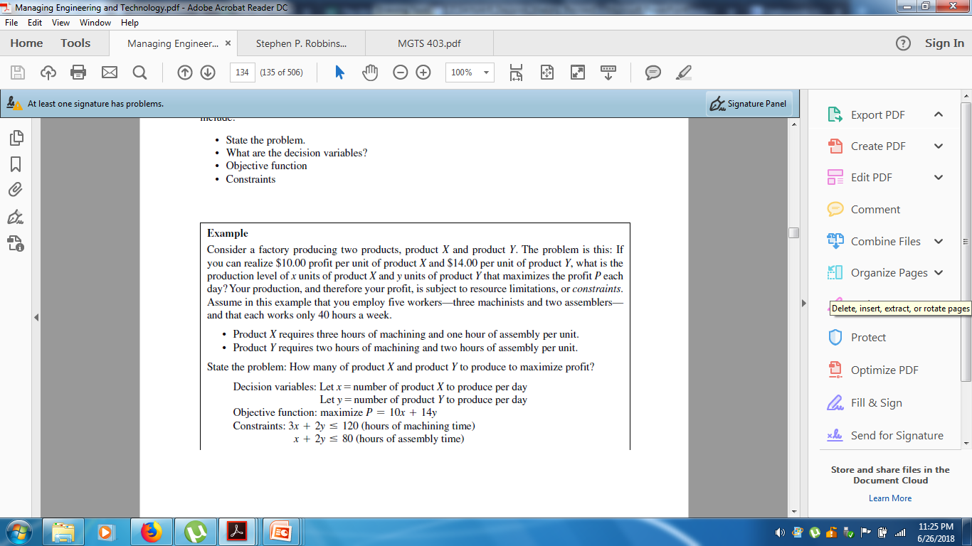

Slide 22
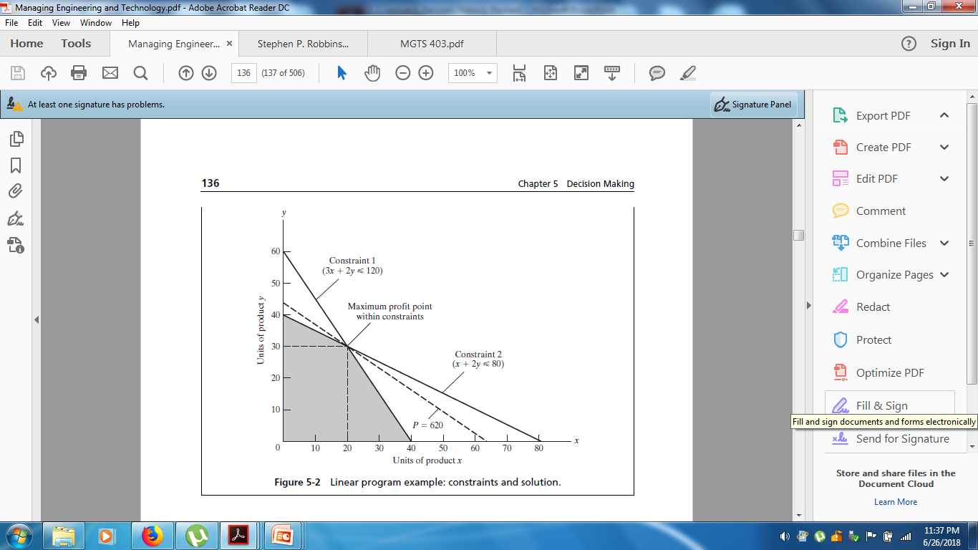

Slide 23
Engineering Economic Analysis
Time Value of Money
Minimum Acceptable Rate of Return
Decision Criteria
Net Present Worth
Equivalent Annual Worth
Internal Rate of Return
Benefit / Cost Ratio

Slide 24
Decision Making under Risk
Expected Value / Decision Trees
Queuing (Waiting-Line Theory)
Simulation

Slide 25
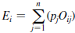
Expected Value
Given the future states of nature and their probabilities, the solution in decision making under risk is the alternative A_{i} that provides the highest expected value E_{i}

Slide 26
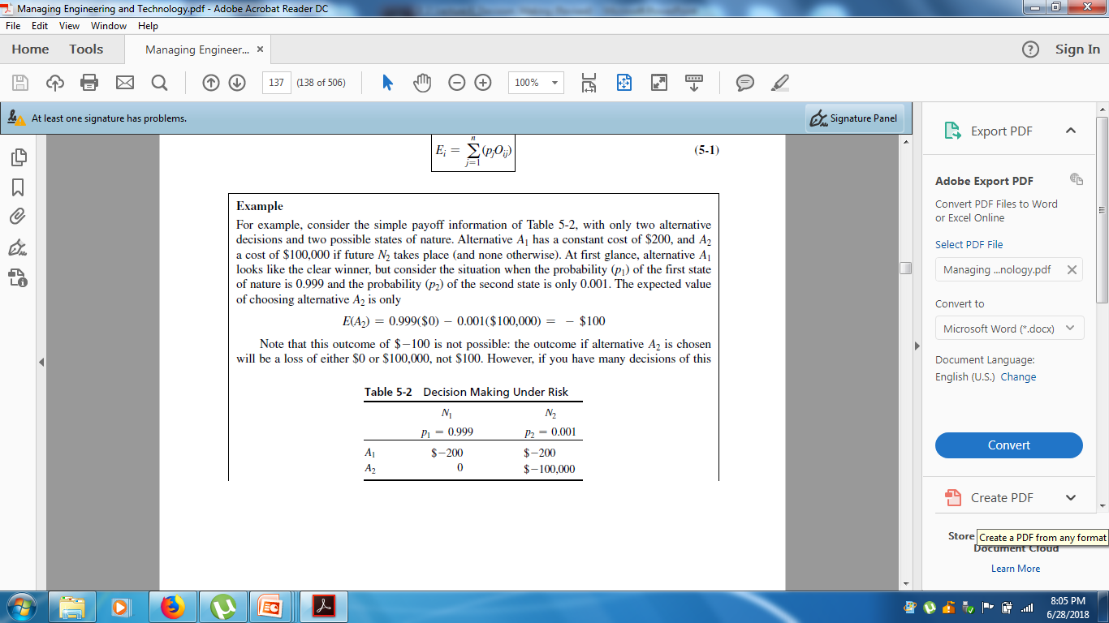
Expected value of Alternative A₁
E(A₁)=(-$200) * 0.999+(-$200)*0.001
= - $199.8 – $ 0.2
= -$200
Expected value of Alternative A₂
E (A₂) =0 * 0.999 – 100,000* 0.001= -$100

Slide 27
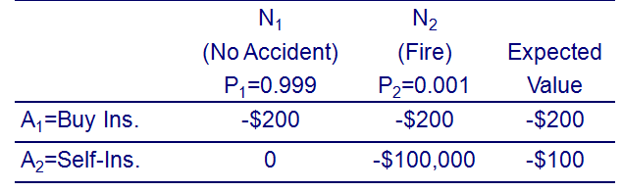

Slide 28
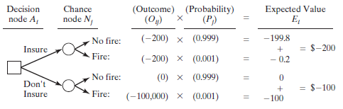
Decision trees provide another technique used in finding expected value.
provide a very visible solution procedure, especially when a sequence of decisions, chance nodes, new decisions, and new chance nodes exist.

Slide 29
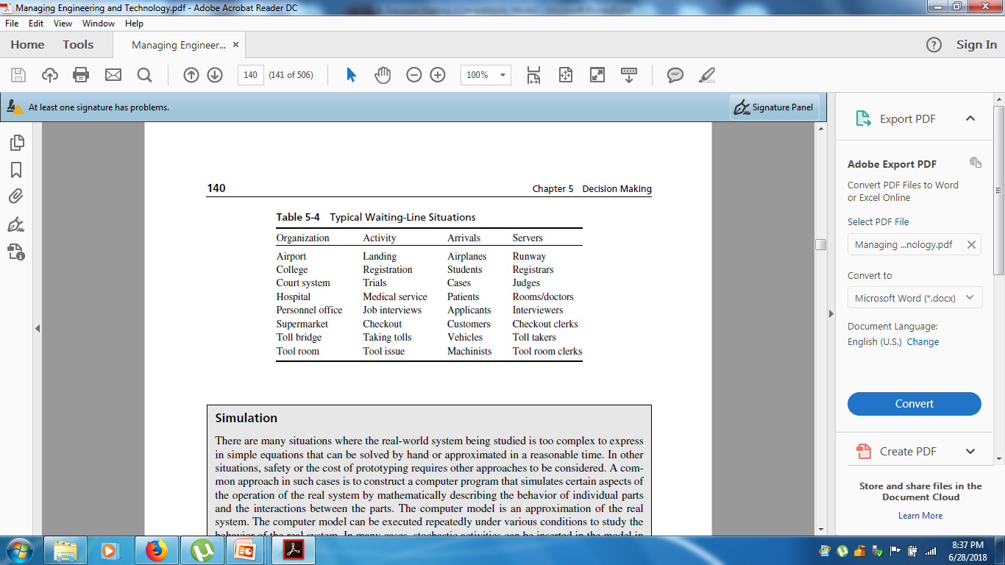
Queuing Theory
The essence of the typical queuing problem is identifying the optimum number of servers needed to reduce overall cost.
Mathematical expressions for mean queue length and delay as a function of mean arrival and service rates have been developed for a number of probability distributions (in particular, exponential and Poisson) of arrival and of service times.

Slide 30
Simulation
In case real-world system is too complex to express in simple equations, construct a model that simulates operation of a real system by mathematically describing behavior of individual interrelated parts.
For instance, time between arrivals and services can be represented by probability distributions.
Develop a computer program for one cycle of operation, and Run it for many cycles.
Simulation modeling seeks to:
Describe the behavior of a system
Use the model to predict future behavior, i.e. the effects that will be produced by changes in the system or in its method of operation.

Slide 31
There are three categories of computer simulations
Live simulations have real people and real equipment operating in a simulated environment. Example training exercises conducted by the military.
Virtual simulations have real people using simulated equipment. Example would be a driving simulator or computer games, such as a flight simulator.
Constructive simulations have simulated people and equipment, Example what might be found in a model of a factory production layout or airport screening operation.
Live and virtual simulations are typically used where safety is an important consideration. Constructive simulations are typically used where cost, decision making, and prototyping limit
implementing the real system.

Slide 32
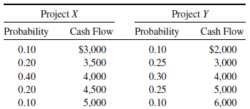
Risk as Variance Risk = Variability of Outcome Measurement of variability: variance or standard deviation

Slide 33
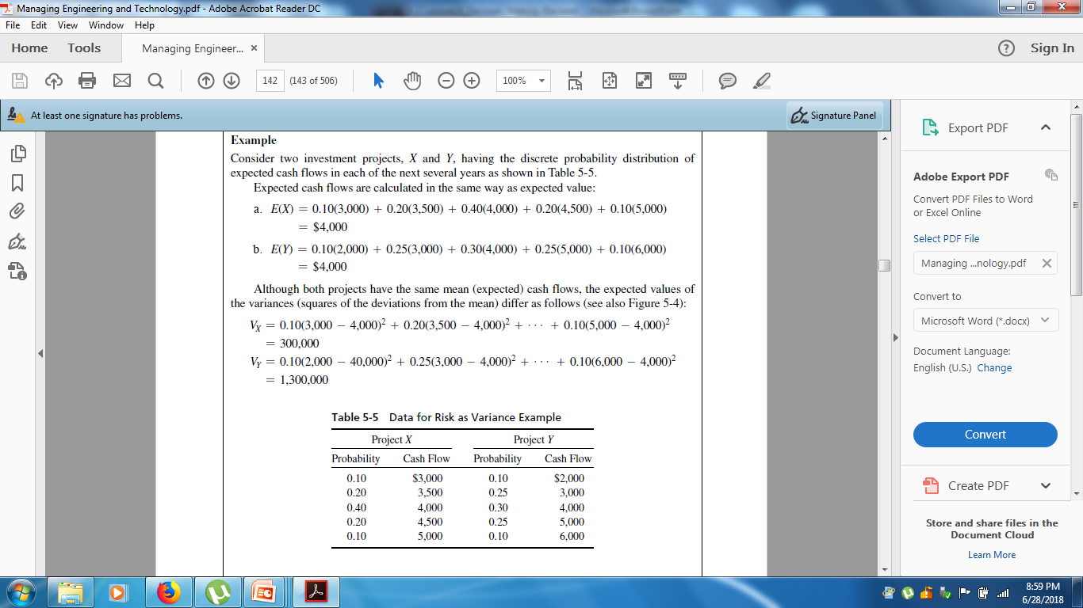
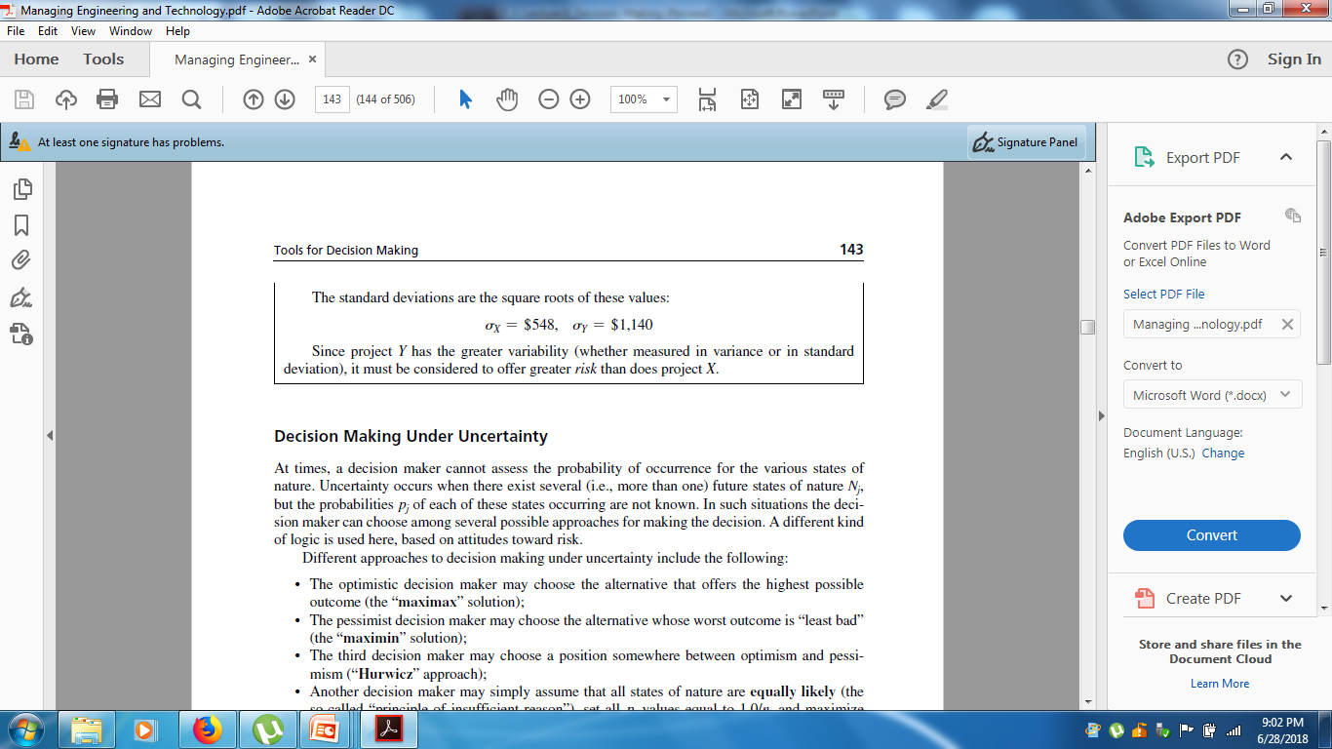

Slide 34


Slide 35
Decision Making under Uncertainty
Uncertainty occurs when there exist several (i.e., more than one) future states of nature N_{j}, but the probabilities p_{j} of each of these states occurring are not know.
In such situations the decision maker can choose among several possible approaches for making the decision.

Slide 36
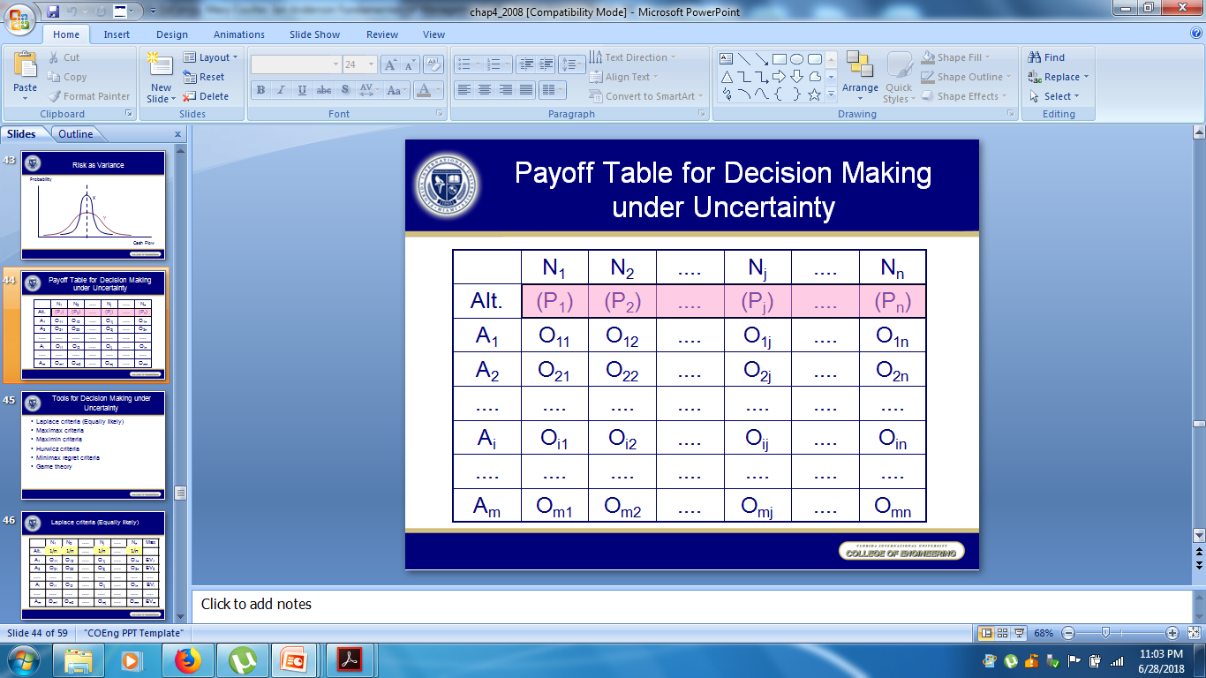

Slide 37
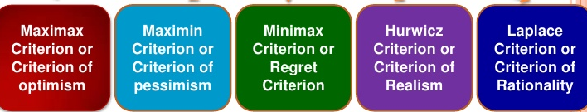
Decision Making Approaches under Uncertainty

Slide 38
The optimistic decision maker may choose the alternative that offers the highest possible outcome(the “maximax” solution);
The pessimist decision maker may choose the alternative whose worst outcome is “least bad”(the “maximin” solution);
The third decision maker may choose a position somewhere between optimism and pessimism(“Hurwicz” approach);
Another decision maker may simply assume that all states of nature are equally likely (the so-called “principle of insufficient reason”), set all pj values equal to 1.0/n, and maximize expected value based on that assumption.
The fifth decision maker may choose the alternative that has the smallest difference between the best and worst outcomes (the “minimax regret” solution). Regret here is understood as proportional to the difference between what we actually get, and the better position that we could have received if a different course of action had been chosen. Regret is sometimes also called “opportunity loss.” The minimax regret rule captures the behavior of individuals who spend their post-decision time regretting their choices.

Slide 39
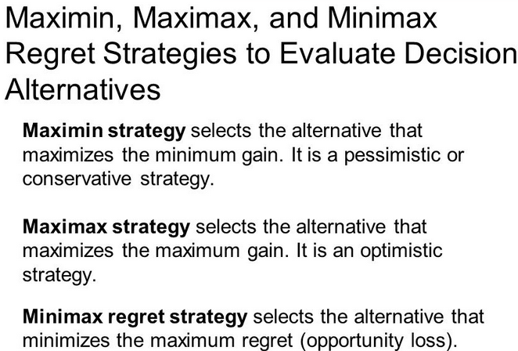

Slide 40
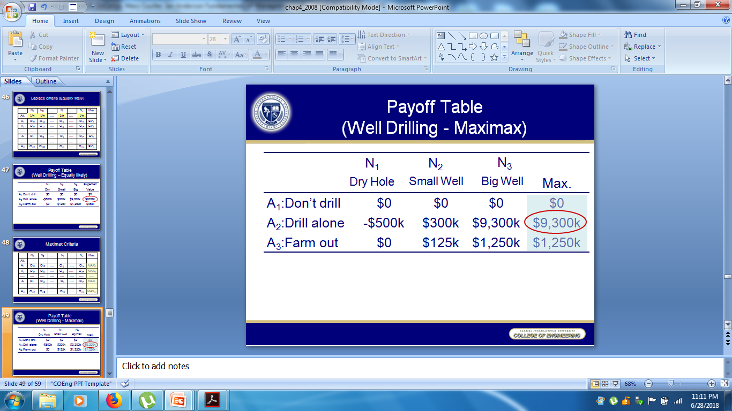
Maximax

Slide 41
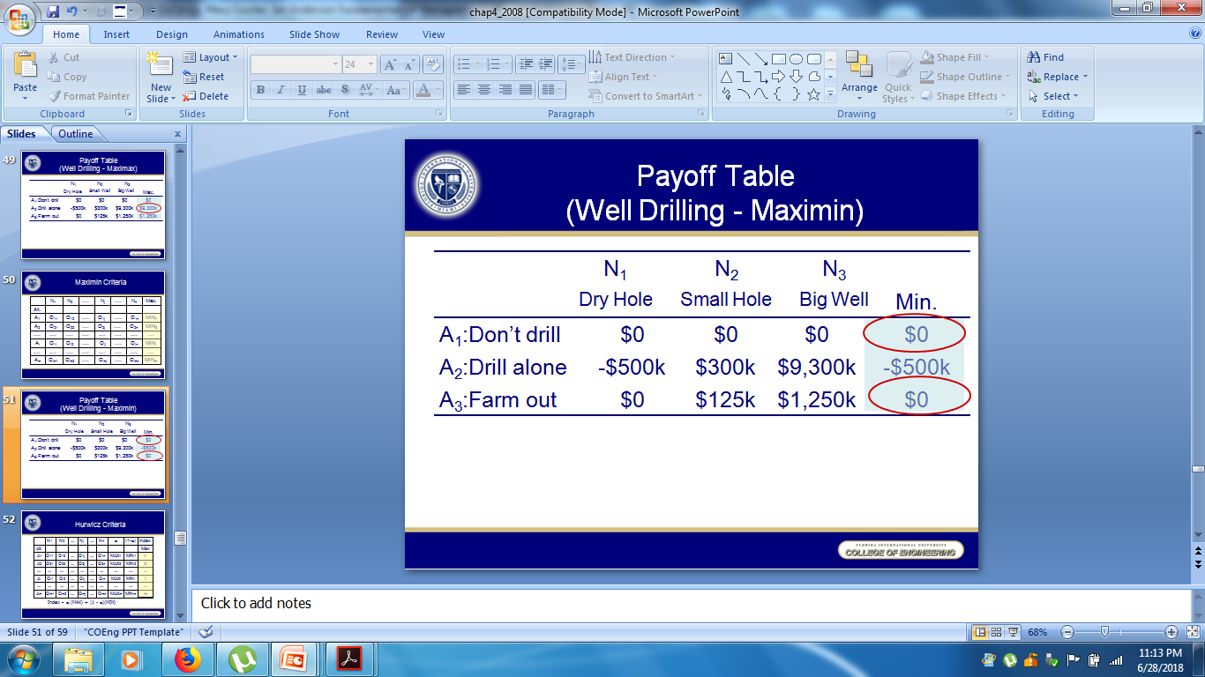
Maximin

Slide 42
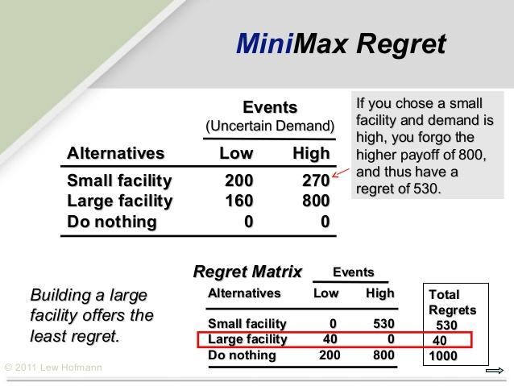
Minimax

Slide 43
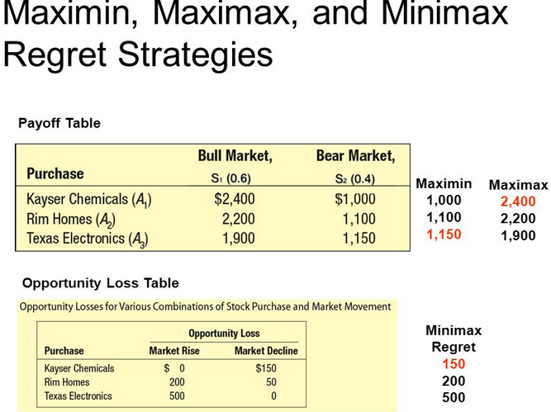

Slide 44
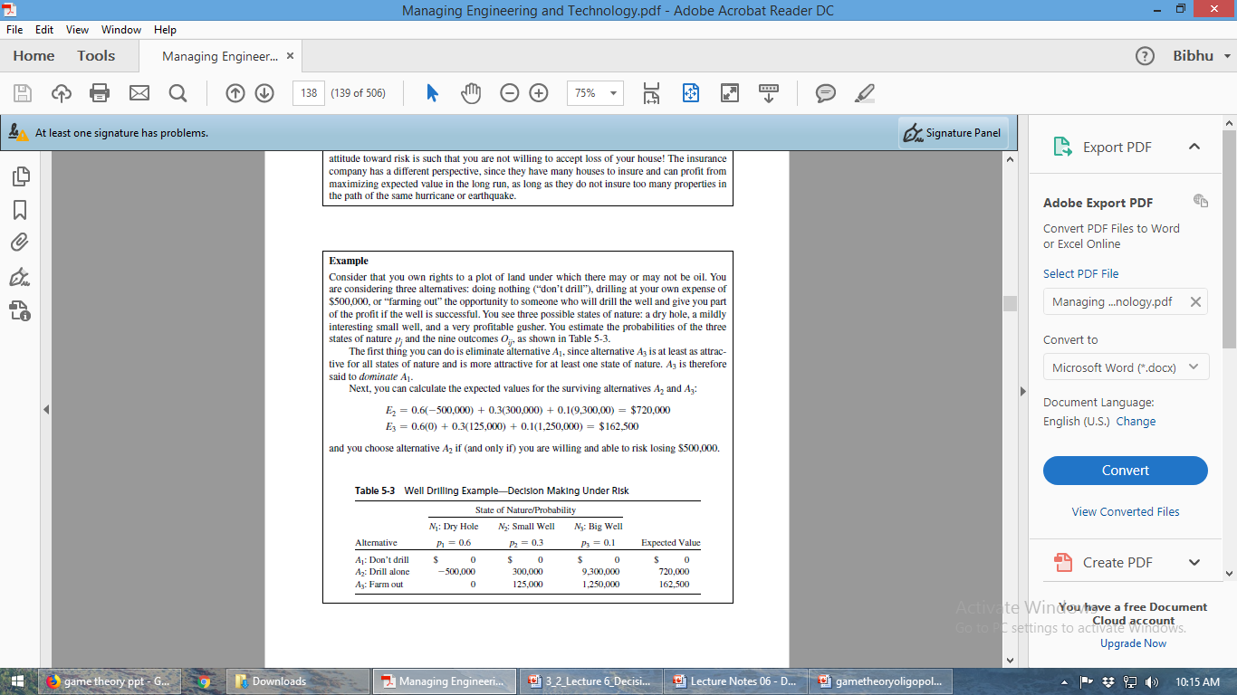
Example:

Slide 45
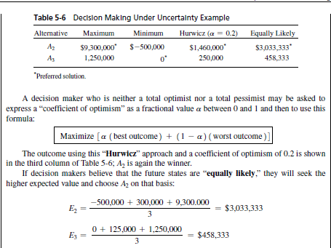

Slide 46
Game Theory
The future states of nature and their probabilities are replaced by the decisions of a competitor.
Begley and Grant explain: In essence, game theory provides the model of a contest. The contest can be a war or an election, an auction or a children’s game, as long as it requires strategy, bargaining, threat, and reward.
Leads to selecting a mixture of two or more strategies, alternated randomly with some specified probability.
Begley and Grant provide a simple example: In the children’s game called Odds and Evens, for instance, two players flash one or two fingers. If the total is 2 or 4, Even wins; if [it is] 3, Odd wins. A little analysis shows that the winning ploy is to randomly mix up the number of fingers flashed. For no matter what Odd does, Even can expect to come out the winner about half the time, and vice versa. If Even attempts anything trickier, such as alternating 1s and 2s, he can be beaten if Odd catches on to the strategy and alternates 2s and 1s.

Slide 47
Computer-Based Information Systems
Integrated Databases
Same data stored in various system over and over again has been now integrated in same system
Cost, Time,Space etc
Management Information/Decision Support Systems
Expert Systems

Slide 48
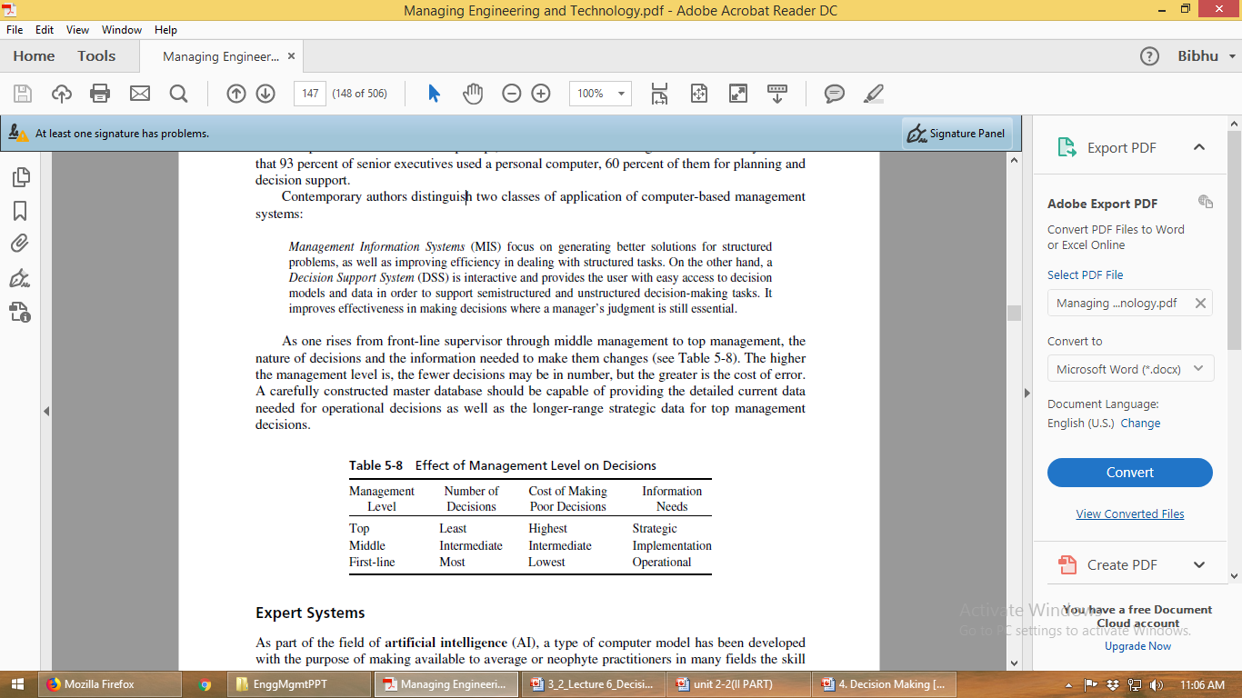
Management Information/Decision Support Systems

Slide 49
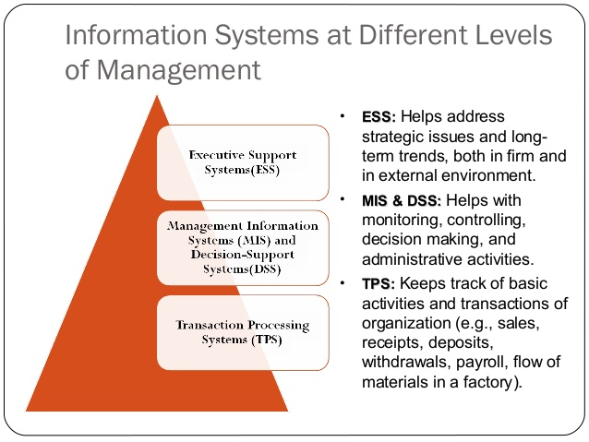

Slide 50
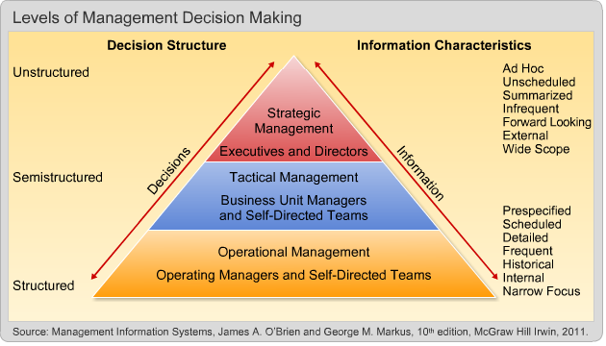

Slide 51
Transaction Processing Systems (TPS)
Automate handling of data about business activities (transactions)
Management Information Systems (MIS)
Converts raw data from transaction processing system into meaningful form
Decision Support Systems (DSS)
Designed to help decision makers
Provides interactive environment for decision making
Expert Systems (ES)
Replicates decision making process
Knowledge representation describes the way an expert would approach the problem

Slide 52
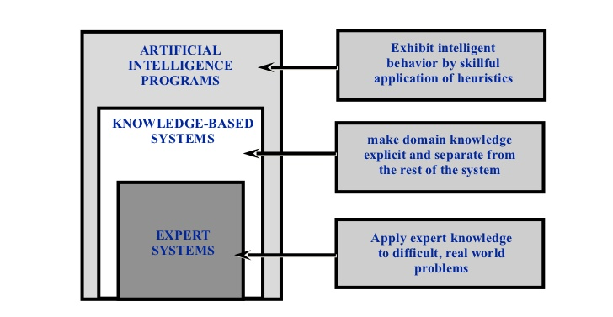
Expert Systems

Slide 53
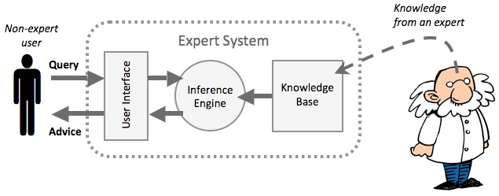

Slide 54
Implementation
Decisions, no matter how well conceived, are of little value until they are put to use—that is, until they are implemented.
Koestenbaum puts it well:
Leadership is to know that decisions are merely the start, not the end.
Next comes the higher level decision to sustain and to implement the original decision, and that requires courage.
Courage is the willingness to submerge oneself in the loneliness, the anxiety, and the guilt of a decision maker. Courage is the decision, and a decision is, to have faith in the crisis of the soul that comes with every significant decision. The faith is that on the other end one findsin oneself character and the exhilaration of having become a strong, centered, and grounded human being.

